Slide 1
Innateness in machines: Causal Inference
A talk by Riccardo Bassani & Otto Mättas

Slide 2
Outline
Innateness
“Innateness, AlphaZero and Artificial Intelligence”, G. Marcus
Causal Inference
“The Seven Tools of Causal Inference, with Reflections on Machine Learning”, J. Pearl
What is innateness?
Nativism vs Empiricism
Innateness in machines
Innateness in Alpha Zero
What should be innate? → Causality
What is causal inference?
Three layers of inference
Tools for analysing causality
Frame problem
A possible solution for finding intelligence?

Slide 3
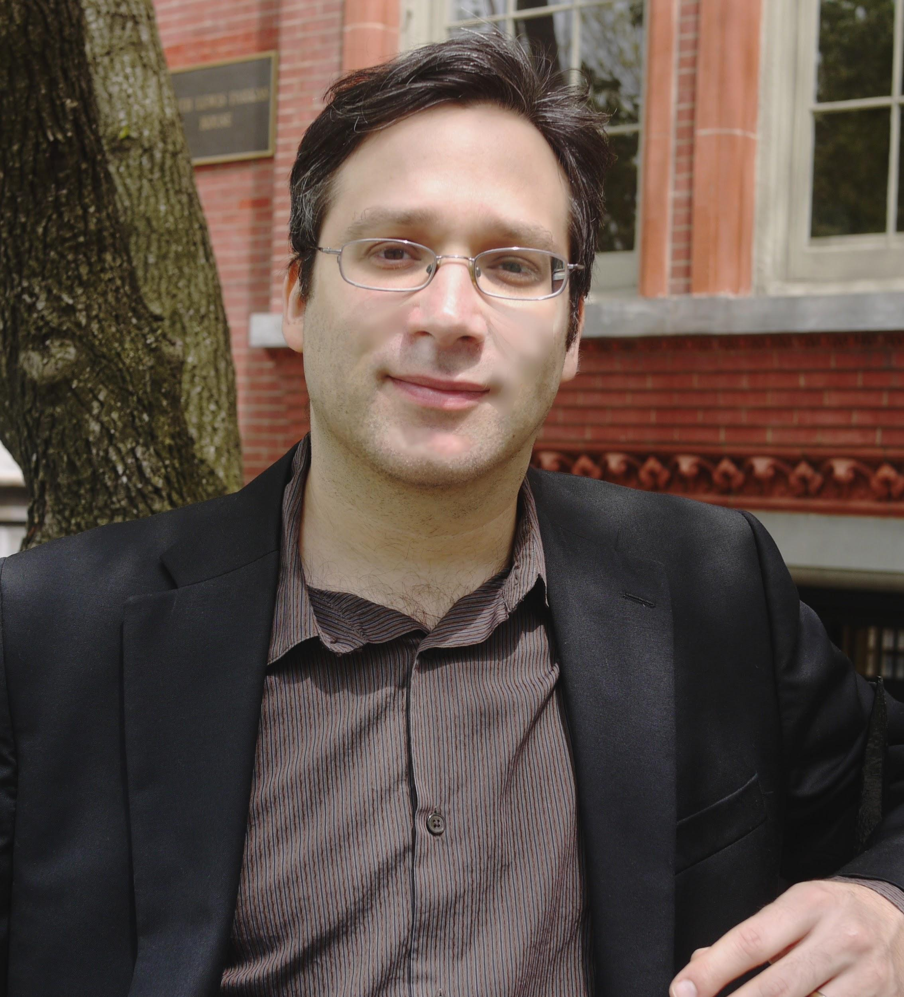
What is innateness?
The idea of something being acquired independently of learning.
Gary Marcus

Slide 4
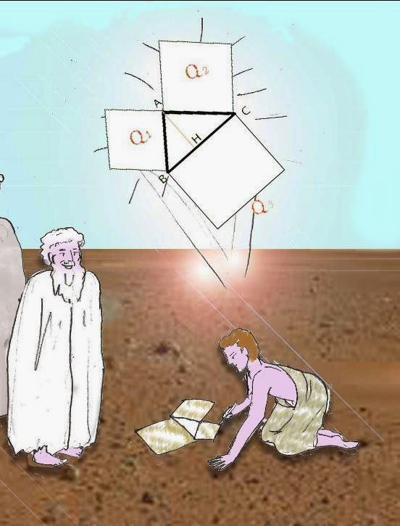
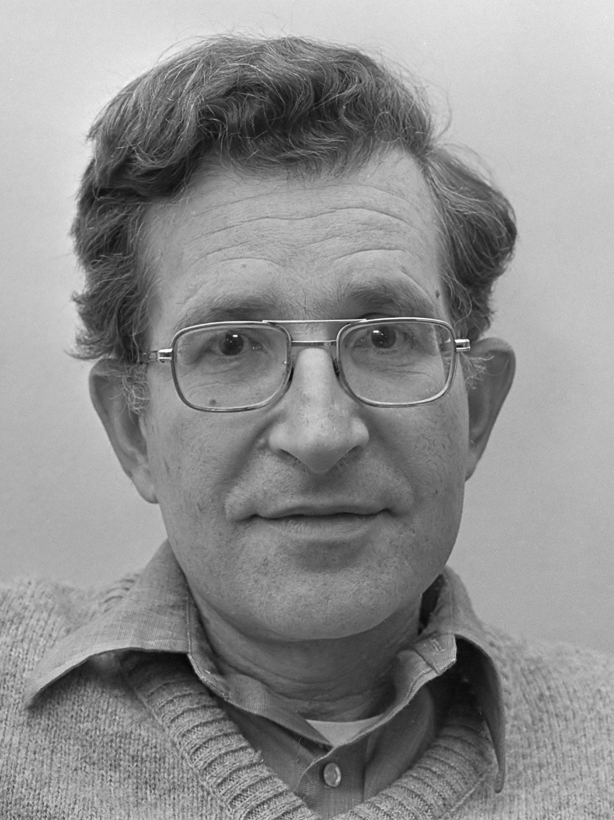
Nativism
Most basic skills are hard-wired in the brain at birth
Plato
Chomsky
Meno
(~385 B.C.)
Language Acquisition Device
(1965)

Slide 5
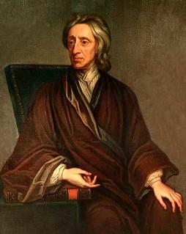
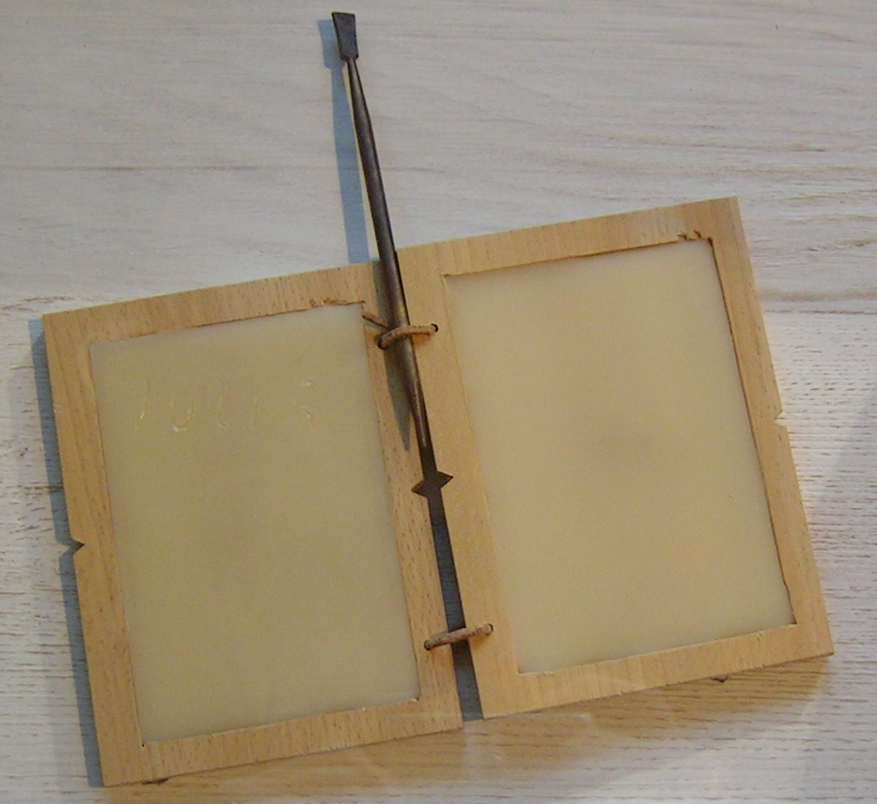
Empiricism
All knowledge is based on experience
Locke
Tabula rasa
(1694)

Slide 6
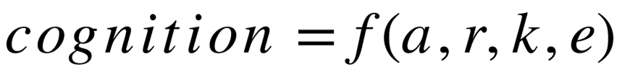

Innateness in machines
a = innate algorithms
r = innate representational formats
k = innate knowledge
e = experience
Nativists
Empiricists

Slide 7
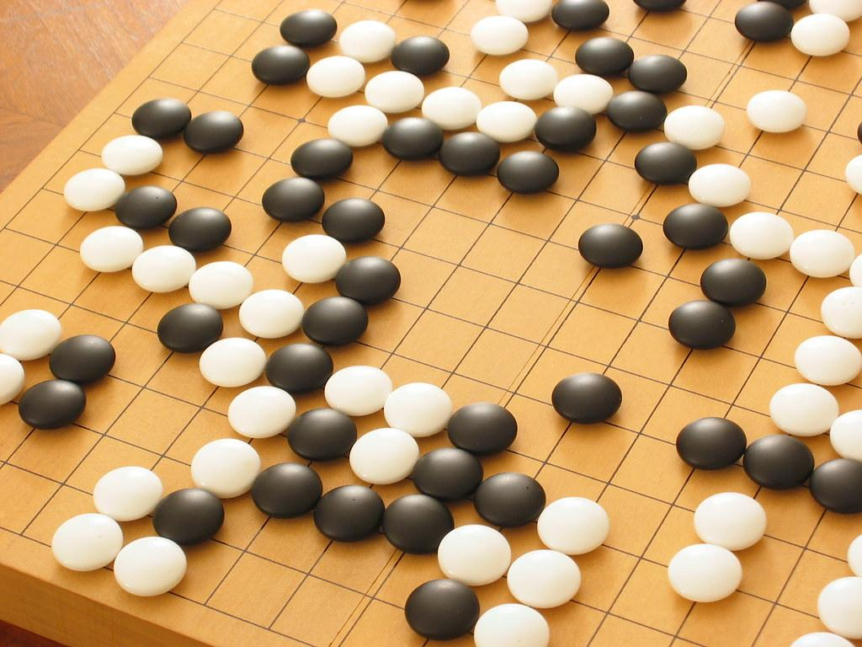
Innateness in machines
a = innate algorithms
r = innate representational formats
k = innate knowledge
e = experience
Evidence for innate machinery in humans
Proofs that a and r cannot be zero in machines
still
“...most ML people believe that methods for incorporating prior knowledge in the form of symbolic rules (or their probabilistic equivalent) are too heavy-handed.”
Thomas G. Dietterich
WHY?
Alpha Zero

Slide 8
Innateness in Alpha Zero
“Mastering the game of Go without human knowledge”
“A pure reinforcement learning approach is fully feasible, even in the most challenging of domains”
Actually there is a considerable amount of INNATE MACHINERY!
Monte Carlo tree search
Convolution
Knowledge about the game (rules, board size)
evaluating moves
translation invariant
board patterns

Slide 9
Innateness in Alpha Zero
Alpha Zero has actually extra innate machinery w.r.t.:
Atari system (e.g. no Monte Carlo search, no game rules)
Human mind (arguably no Monte Carlo search, certainly no game rules)
Negative argument: Alpha Zero did not renounce to innate machinery
Positive Argument: Successful thanks to the right innate machinery
What should be innate in an intelligent machine?

Slide 10
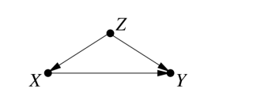
What should be innate?
10 primitives:
e.g.
• Spatiotemporal contiguity
• Capacity for cost-benefit analysis
• Causality

Slide 11
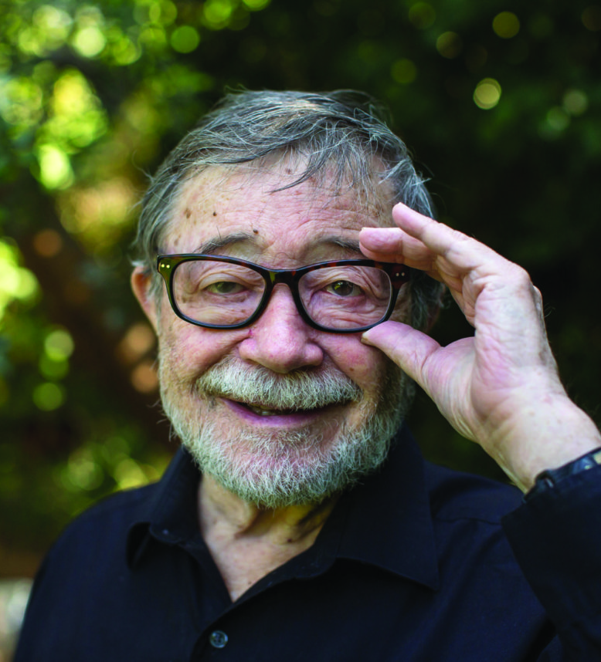
What is causal inference?
A process of analysing the response of the effect variable when the cause is changed - or more commonly, the causal relations.
Judea Pearl
Notes:
Causal inference is a process of analysing the response of the effect variable when the cause is changed - or more commonly, the causal relations.

Slide 12
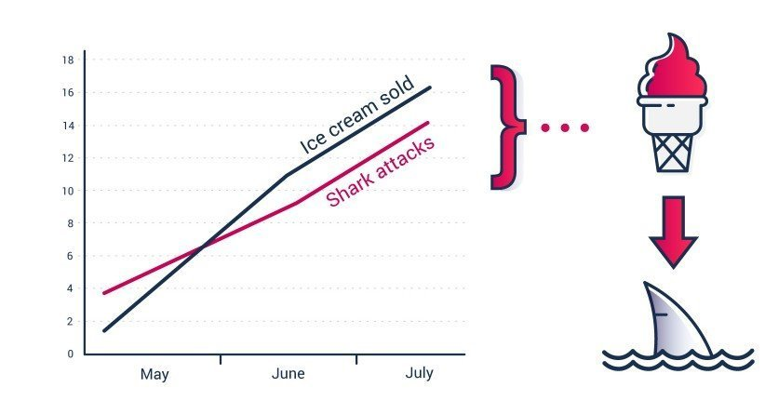
Correlation ≠ Causation
Notes:
We observe from data that the number of sold ice cream and the number of shark attacks are correlated.
Can we then infer that eating ice-cream makes it more probable to be eaten by a shark? Of course not!
In this case there is a third variable the location, that is a common cause. In warm places on the sea, people buy more ice-creams and there are more shark-attacks!

Slide 13
Three layers of inference
Layer (Symbol) | Typical Activity | Typical Questions | Examples
Association P(y|x) | Seeing | What is? How could seeing X change my belief in Y? | What does a symptom tell me about a disease? What does a survey tell us about the election results?
Intervention P(y|do(x),z) | Doing, Intervening | What if? What if I do X? | What if I take aspirin, will my headache be cured? What if we ban cigarettes?
Counterfactuals P(yₓ|x′,y′) | Imagining, Retrospecting | Why? Was it X that caused Y? What if I had acted differently? | Was it the aspirin that stopped my headache? Would Kennedy be alive had Oswald not shot him? What if I had not been smoking the past two years?
Notes:
Please bare with us on this one. It will take some time but is also essential to know.
Association
What is the association between two variables?
I am a common mortal and observe the weather data about several days. I also observe that rain and mud have a tendency to occur on the same day.
I can say there is a correlation between the mud and rain.
But I cannot infer what is the actual causal relation, if any.
Only based on data I can not infer if mud causes rain or rain causes mud, if any. So to answer this question of causation, we have to pass to the second layer.
Intervention
What if I do, what happens then?
Let’s suppose I’m god or at least in weather control. I will make a beautiful day muddy, will it rain? If so, the mud is the cause and rain is the effect…
Now, I will make it rain on a beautiful day, will it become muddy? If so, the rain is the cause and mud is the effect…
This is something I can do by acting in the world. Even though I cannot make rain, the example still applies.
Let’s go one layer deeper.
Counterfactuals
We are thinking about possible worlds and the possible states.
Was it the rain that created the mud? Or what was it? Why?
To answer this, I would have to become the lord of all of the gods - I would need to go back in time to see what would have happened if I had created rain and did not change any other aspects of the world. With interventions, we are not sure that any other aspect of the world did not change.
Difficulty in answering is increasing layer by layer.
Questions on a lower level need to be answered before the higher layer can be answered.
Observation is enough for the association layer but not the intervention or counterfactuals.
Machine learning is great for association but cannot deal with intervention and counterfactuals.

Slide 14
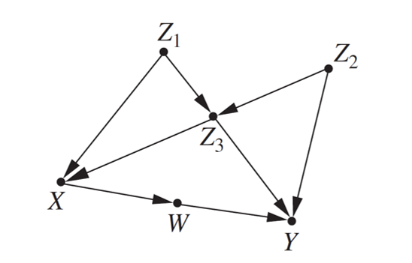
SCM: Structural Causal Model
Causality
Notes:
Causal models are mathematical models representing causal relationships within an individual system or population.
On the screen, you can see just one visual representation of such a model.

Slide 15
Seven Tools of the SCM framework
Encoding causal assumptions: Transparency and testability
Do-calculus and the control of confounding
The algorithmization of counterfactuals
Mediation analysis and the assessment of direct and indirect effects
Adaptability, external validity, and sample selection bias
Causal discovery
Recovering from missing data
Notes:
Pearl has proposed a few tools within the SCM framework as he calls it, to help us where pure logic and having data does not help.
The first five you need to look at yourself, we are going to focus on two.
The first one might be interesting here for the last team presenting. Anyway...
First, causal discovery aims to find causal relations by analyzing observational data. When we have little or missing information, we have ways of discovering the relations.
Systematic searches have been developed that, in certain circumstances, can prune the set of compatible models significantly to the point where causal queries can be estimated directly from that set.
There are alternative methods for discovery, proposed by Shimizu and Tian / Pearl but in the sake of our presentation, I won’t go into them.

Slide 16
Discussion

Slide 17
The
Frame Problem
and recovering relationships from missing data
Notes:
Problems due to missing data plague every branch of experimental science. Respondents do not answer every item on a questionnaire, sensors malfunction as weather conditions worsen, and patients often drop from a clinical study for unknown reasons.
In artificial intelligence, the frame problem describes an issue with using first-order logic (FOL) to express facts about an agent in the world. The frame problem is the problem of finding adequate collections of axioms for a viable description of the agent’s environment. We know what we can ignore and what we cannot ignore to describe the agent’s environment. So we don’t have to explicitly represent the non-effects.
EXAMPLE. We know that the way gravity works will not change when we move from kitchen to the bathroom while the agent does not know this. Which means our position inside the house is not relevant for gravity.
Also, we know that it is not necessary to think about gravity when moving from kitchen to the bathroom but the agent does not know this.
Using causal models and the missingness process we can now formalize the conditions under which causal and probabilistic relationships can be recovered from incomplete data and, whenever the conditions are satisfied, produce a consistent estimate of the desired relationship. The SCM framework will give us the needed relations to complete the environmental description for the agent to be successful. It is a needed step towards intelligence because what if we say the agent is successful when it is intelligent?

Slide 18

Discussion
Innate Machinery
Machines just do “what they are programmed for”

Slide 19
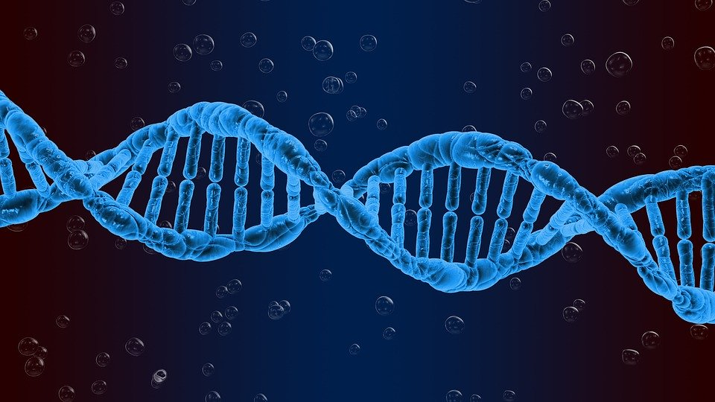
Discussion
Innate Machinery
Machines just do “what they are programmed for”
Machine code
Human code

Slide 20
Discussion
Innateness + Learning
Intelligence

Slide 21
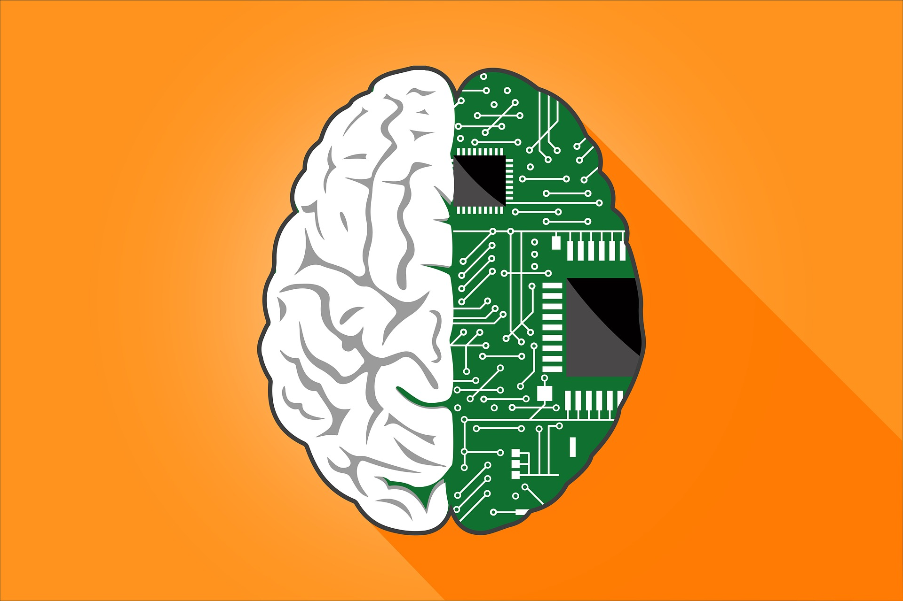
What to learn?
What pre-wired?

